Slide 1
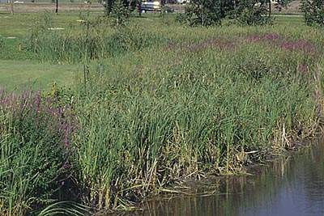
Purple Loosestrife competing with cattail
Figure 2. Purple loosestrife invades wetland areas and displaces native plants, such as cattails shown here.
Lessoning Loosestrife
Notes:
http://www.ag.ndsu.edu/pubs/plantsci/weeds/w1132w.htm

Slide 2
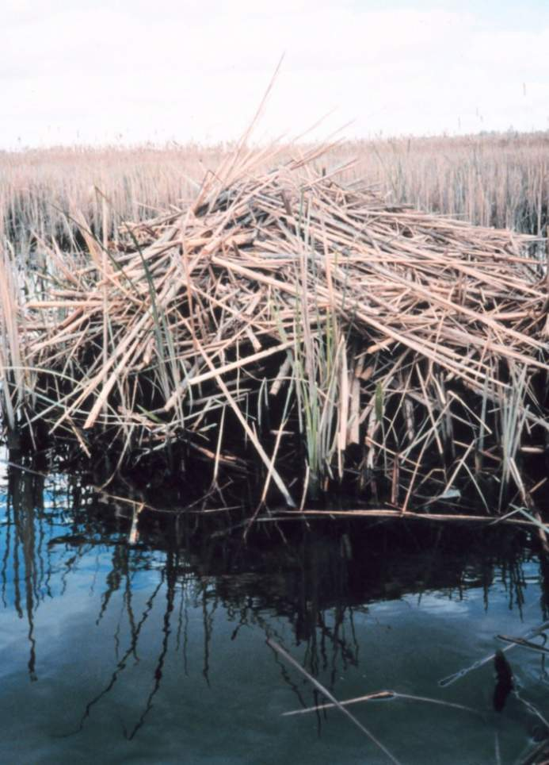
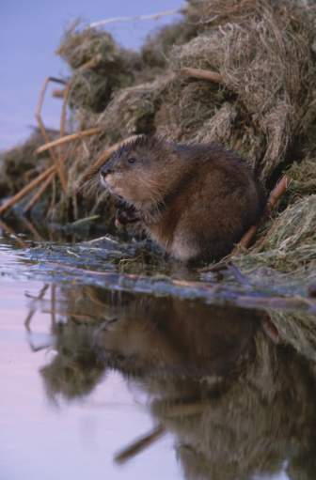
Muskrat Lodge made from Cattail
Photographer: Mary Hollinger, NODC biologist, NOAA
Credit: Christine Humphreys/Painet Inc.
Investigate: What other species might be impacted if purple loosestrife invades?
Lessoning Loosestrife
Notes:
http://usasearch.gov/search?v%3aproject=firstgov-noaa-images&v%3afile=viv_908%4028%3aIlYrda&v%3aframe=viewimage&v%3astate=%28root%29%7croot&id=Ndoc0&rpaid=&

Slide 3
What additional species are impacted when purple loosestrife takes over a wetland?
Lessoning Loosestrife

Slide 4
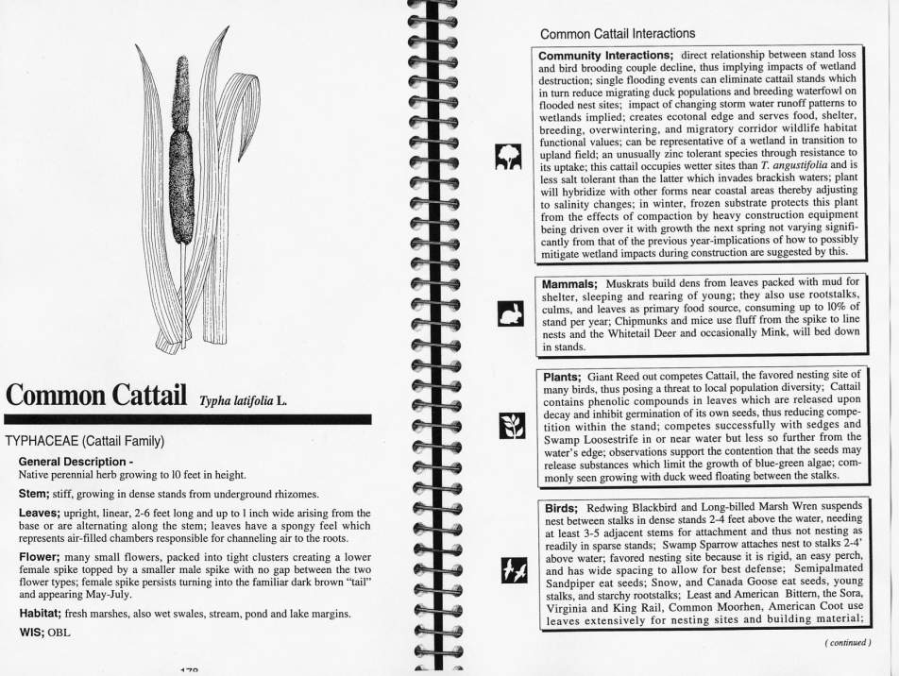
Lessoning Loosestrife
From Redington Field Guide: Plants in Wetlands”

Slide 5
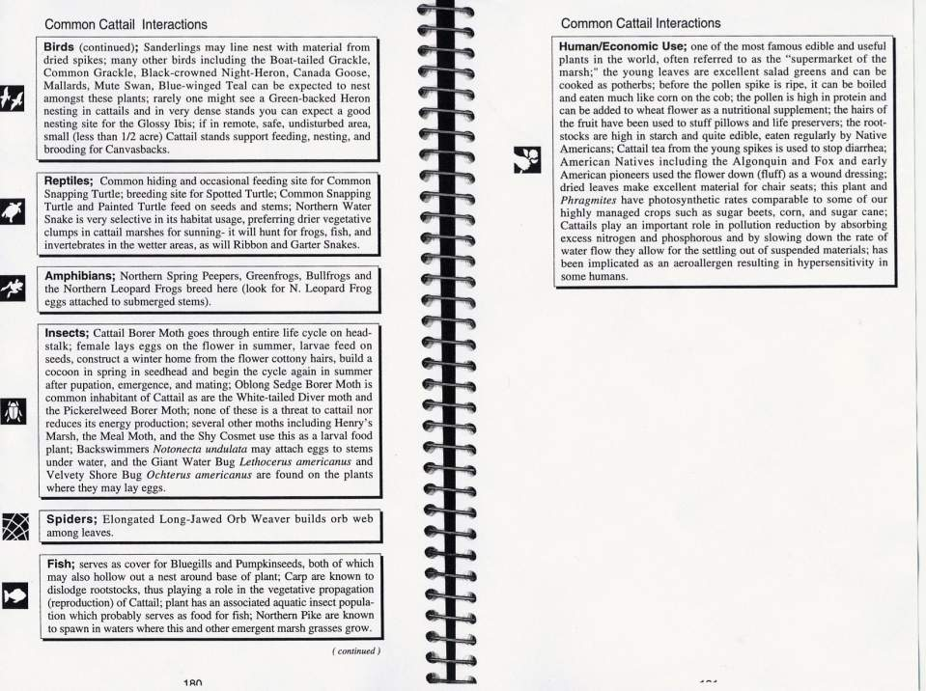
Lessoning Loosestrife
From Redington Field Guide: Plants in Wetlands”

Slide 6
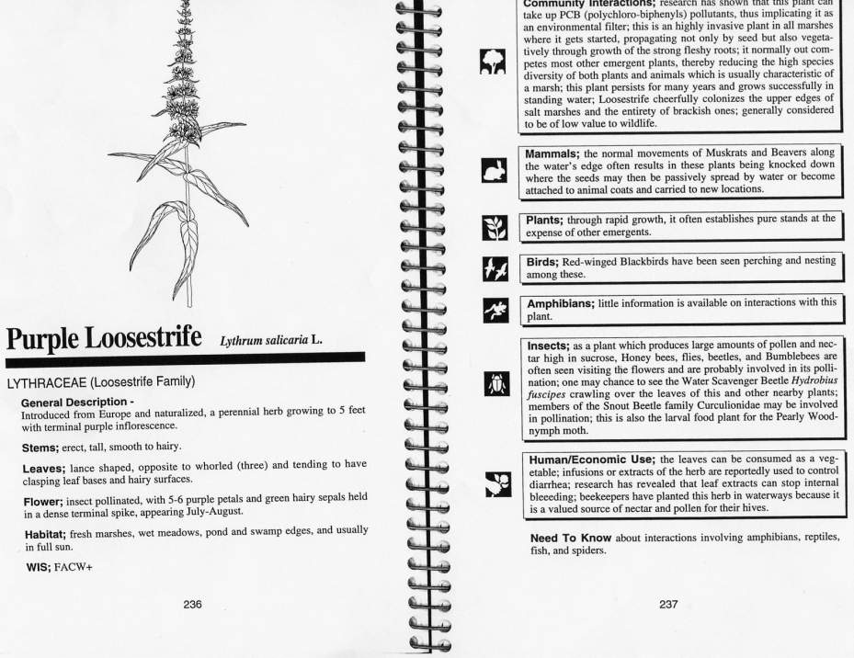
Lessoning Loosestrife
From Redington Field Guide: Plants in Wetlands”

